Slide 1

Mathematics

Slide 2
Session
Matrices and Determinants - 2

Slide 3
Session Objectives
Determinant of a Square Matrix
Minors and Cofactors
Properties of Determinants
Applications of Determinants
Area of a Triangle
Solution of System of Linear Equations (Cramer’s Rule)
Class Exercise

Slide 4
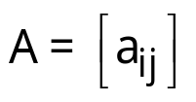
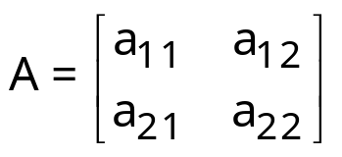
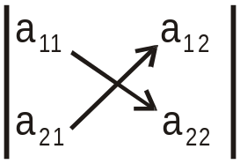
Determinants
If is a square matrix of order 1,
then |A| = | a₁₁ | = a₁₁
If is a square matrix of order 2, then
|A| = = a₁₁a₂₂ – a₂₁a₁₂

Slide 5
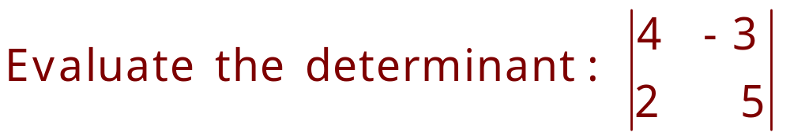
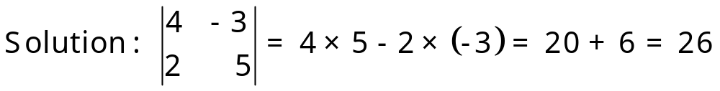
Example

Slide 6
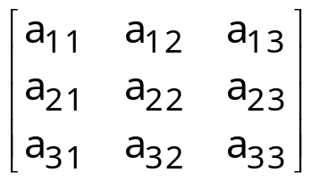
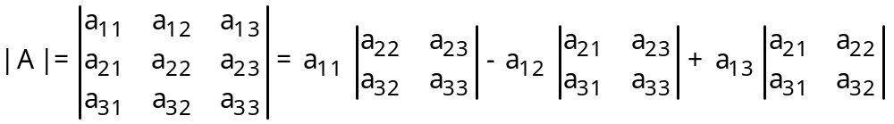
Solution
If A = is a square matrix of order 3, then
[Expanding along first row]

Slide 7
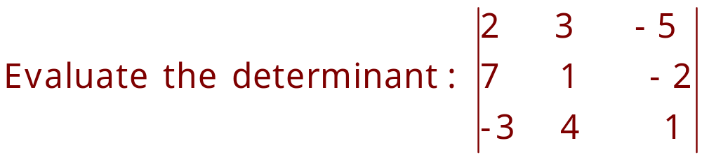
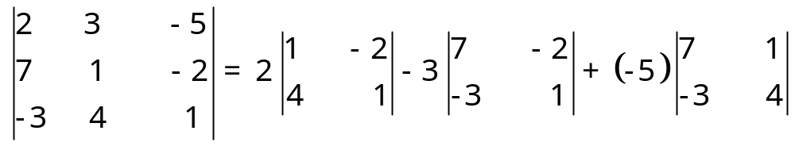
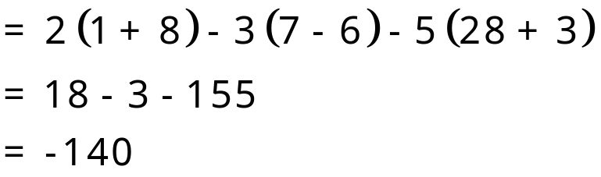
Example
Solution :
[Expanding along first row]

Slide 8
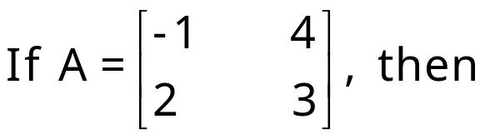
Minors

Slide 9
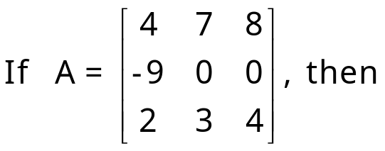
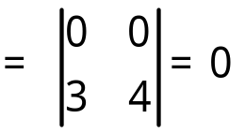
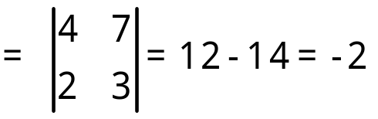
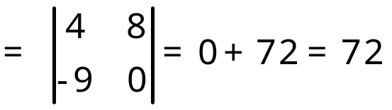
Minors
M₁₁ = Minor of a₁₁ = determinant of the order 2 × 2 square
sub-matrix is obtained by leaving first
row and first column of A
Similarly, M₂₃ = Minor of a₂₃
M₃₂ = Minor of a₃₂ etc.

Slide 10
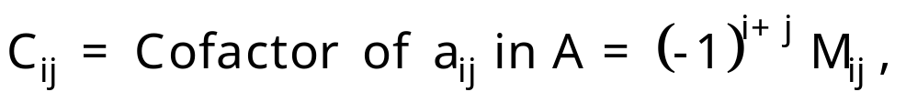

Cofactors

Slide 11
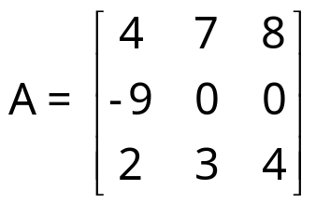
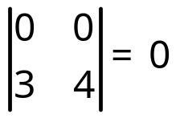
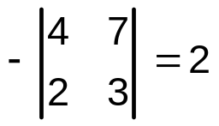
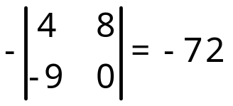
Cofactors (Con.)
C₁₁ = Cofactor of a₁₁ = (–1)¹ ⁺ ¹ M₁₁ = (–1)¹ ⁺¹
C₂₃ = Cofactor of a₂₃ = (–1)² ⁺ ³ M₂₃ =
C₃₂ = Cofactor of a₃₂ = (–1)³ ⁺ ²M₃₂ = etc.

Slide 12
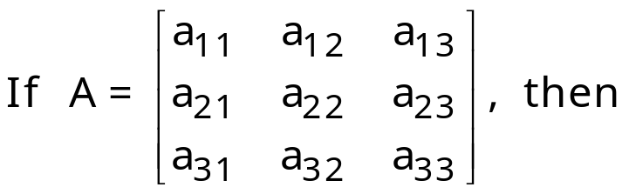
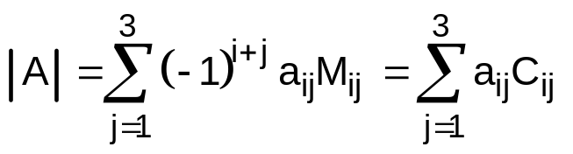
Value of Determinant in Terms of Minors and Cofactors

Slide 13
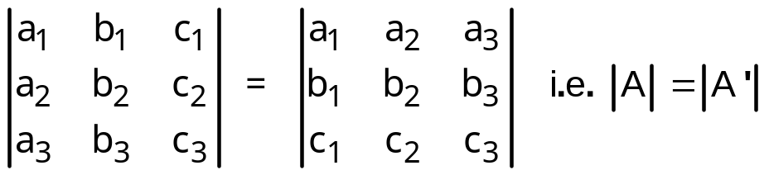
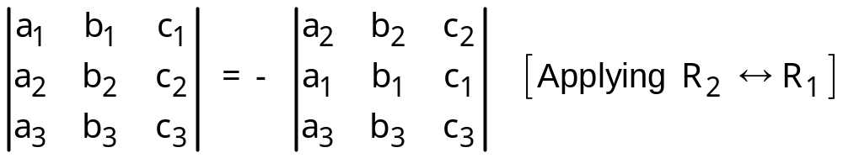
Properties of Determinants
1. The value of a determinant remains unchanged, if its rows and columns are interchanged.
2. If any two rows (or columns) of a determinant are interchanged, then the value of the determinant is changed by minus sign.

Slide 14
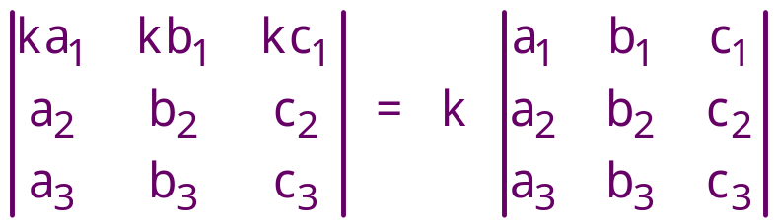
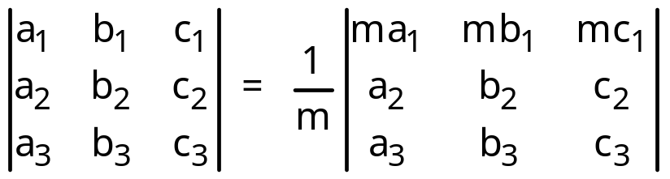
Properties (Con.)
3. If all the elements of a row (or column) is multiplied by a non-zero number k, then the value of the new determinant is k times the value of the original determinant.
which also implies

Slide 15
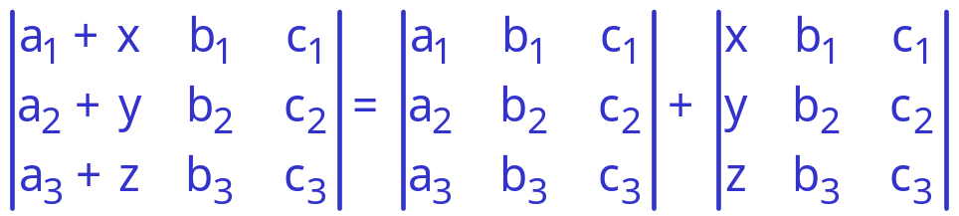
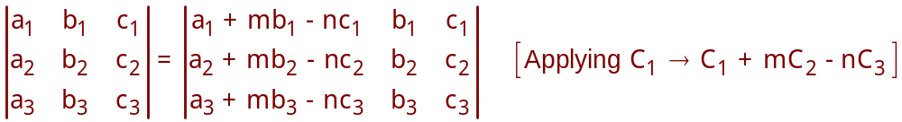
Properties (Con.)
4. If each element of any row (or column) consists of two or more terms, then the determinant can be expressed as the sum of two or more determinants.
5. The value of a determinant is unchanged, if any row (or column) is multiplied by a number and then added to any other row (or column).

Slide 16
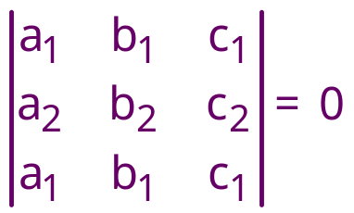
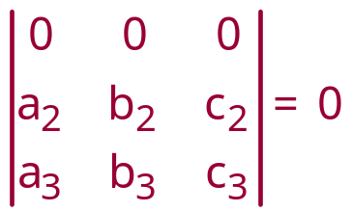
Properties (Con.)
6. If any two rows (or columns) of a determinant are identical, then its value is zero.
If each element of a row (or column) of a determinant is zero,
then its value is zero.

Slide 17
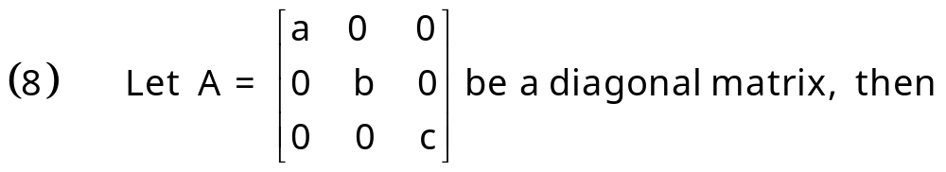
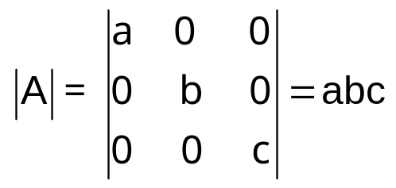
Properties (Con.)

Slide 18

Row(Column) Operations
Following are the notations to evaluate a determinant:
(i) R_{i} to denote ith row
(ii) R_{i} R_{j} to denote the interchange of ith and jth rows.
(iii) R_{i} R_{i} + λR_{j} to denote the addition of λ times the elements of jth row to the corresponding elements of ith row.
(iv) λR_{i} to denote the multiplication of all elements of ith row by λ.
Similar notations can be used to denote column
operations by replacing R with C.
Notes:
If A is the determinant of order 2, then its value can be easily found. But to evaluate determinants of square matrices of higher orders, we should always try to introduce zeros at maximum number of places in a particular row (column) by using properties of determinant.

Slide 19

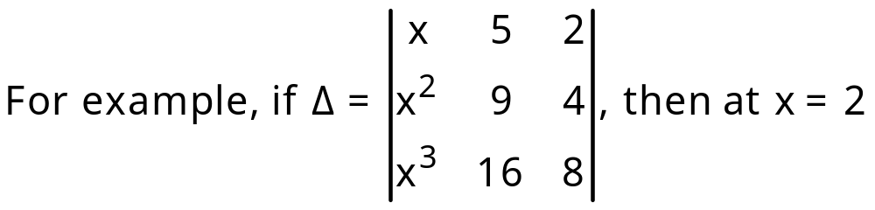


Evaluation of Determinants
If a determinant becomes zero on putting is the factor of the determinant.
, because C₁ and C₂ are identical at x = 2
Hence, (x – 2) is a factor of determinant .

Slide 20
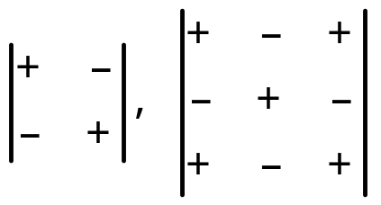
Sign System for Expansion of Determinant
Sign System for order 2 and order 3 are given by

Slide 21
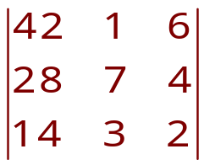
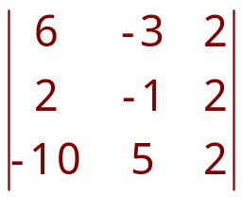
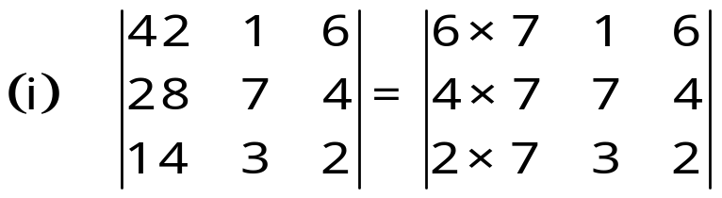
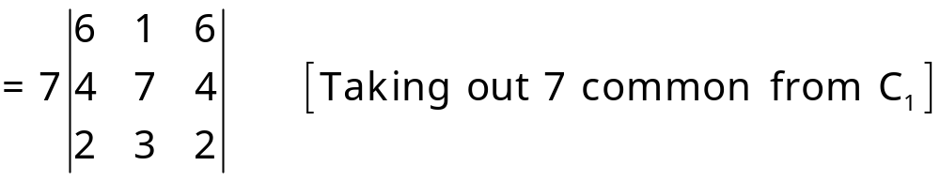
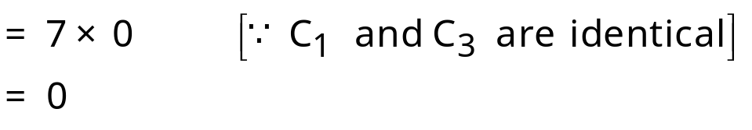
Example-1
Find the value of the following determinants
(i) (ii)
Solution :

Slide 22
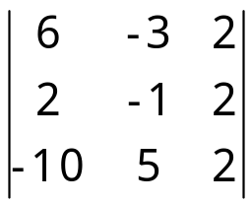
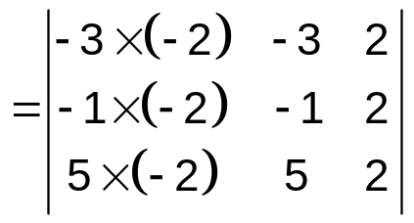
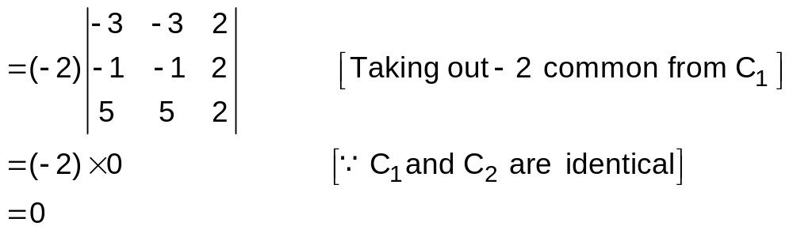
Example –1 (ii)
(ii)

Slide 23
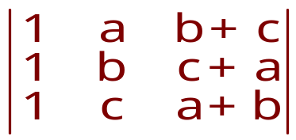
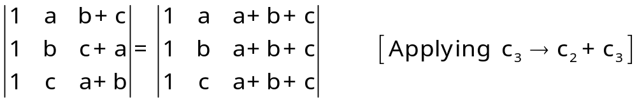
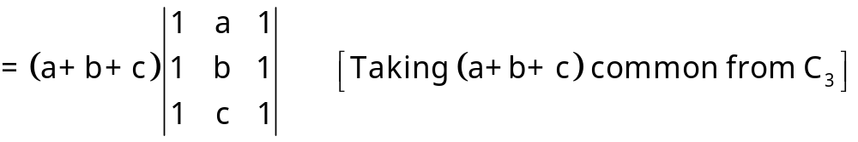
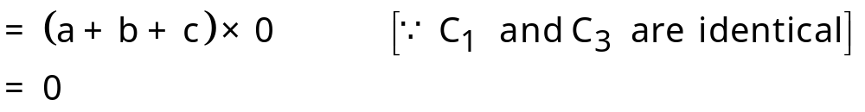
Example - 2
Evaluate the determinant
Solution :

Slide 24
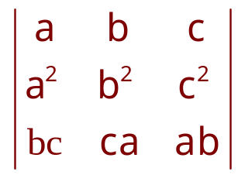
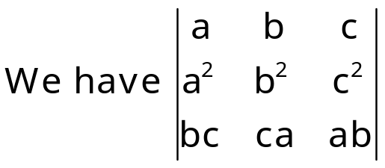
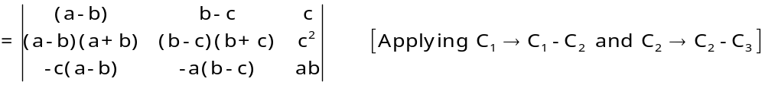
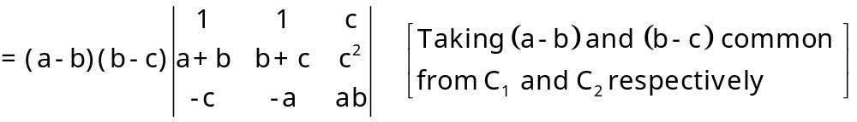
Example - 3
Evaluate the determinant:
Solution:

Slide 25



Solution Cont.
Now expanding along C₁ , we get
(a-b) (b-c) (c-a) [- (c² – ab – ac – bc – c²)]
= (a-b) (b-c) (c-a) (ab + bc + ac)

Slide 26




Example-4
Without expanding the determinant,
prove that
Solution :

Slide 27




Solution Cont.

Slide 28



Example -5
Prove that : = 0 , where ω is cube root of unity.
Solution :

Slide 29



Example-6
Prove that :
Solution :

Slide 30

Solution cont.
Expanding along C₁ , we get
(x + a + b + c) [1(x²)] = x² (x + a + b + c)
= R.H.S

Slide 31




Example -7
Using properties of determinants, prove that
Solution :

Slide 32



Solution Cont.
Now expanding along R₁ , we get

Slide 33



Example - 8
Using properties of determinants prove that
Solution :

Slide 34



Solution Cont.
Now expanding along C₁ , we get

Slide 35



Example -9
Using properties of determinants, prove that
Solution :

Slide 36



Solution Cont.

Slide 37




Example -10
Show that
Solution :

Slide 38


Solution Cont.

Slide 39



Applications of Determinants (Area of a Triangle)
The area of a triangle whose vertices are
is given by the expression

Slide 40



Example
Find the area of a triangle whose vertices are (-1, 8), (-2, -3) and (3, 2).
Solution :

Slide 41

Condition of Collinearity of Three Points
If are three points,
then A, B, C are collinear

Slide 42



Example
If the points (x, -2) , (5, 2), (8, 8) are collinear, find x , using determinants.
Solution :
Since the given points are collinear.

Slide 43




Solution of System of 2 Linear Equations (Cramer’s Rule)
Let the system of linear equations be

Slide 44


Cramer’s Rule (Con.)
then the system is consistent and has unique solution.
then the system is consistent and has infinitely many solutions.
then the system is inconsistent and has no solution.

Slide 45




Example
Using Cramer's rule , solve the following system of equations 2x-3y=7, 3x+y=5
Solution :

Slide 46






Solution of System of 3 Linear Equations (Cramer’s Rule)
Let the system of linear equations be

Slide 47
Cramer’s Rule (Con.)
Note:
(1) If D ≠ 0, then the system is consistent and has a unique solution.
(2) If D=0 and D₁ = D₂ = D₃ = 0, then the system has infinite solutions or no solution.
(3) If D = 0 and one of D₁, D₂, D₃ ≠ 0, then the system
is inconsistent and has no solution.
If d₁ = d₂ = d₃ = 0, then the system is called the system of homogeneous linear equations.
If D ≠ 0, then the system has only trivial solution x = y = z = 0.
(ii) If D = 0, then the system has infinite solutions.

Slide 48



Example
Using Cramer's rule , solve the following system of equations
5x - y+ 4z = 5
2x + 3y+ 5z = 2
5x - 2y + 6z = -1
Solution :
= 5(18+10) + 1(12-25)+4(-4 -15)
= 140 –13 –76 =140 - 89
= 51
= 5(18+10)+1(12+5)+4(-4 +3)
= 140 +17 –4
= 153

Slide 49



Solution Cont.
= 5(12 +5)+5(12 - 25)+ 4(-2 - 10)
= 85 + 65 – 48 = 150 - 48
= 102
= 5(-3 +4)+1(-2 - 10)+5(-4-15)
= 5 – 12 – 95 = 5 - 107
= - 102

Slide 50

Example
Solve the following system of homogeneous linear equations:
x + y – z = 0, x – 2y + z = 0, 3x + 6y + -5z = 0
Solution:
Putting z = k, in first two equations, we get
x + y = k, x – 2y = -k

Slide 51



Solution (Con.)
These values of x, y and z = k satisfy (iii) equation.

Slide 52

Thank you

